Slide 1
Repairing Inconsistent Curve Networks on Non-parallel Cross-sections
Z. Y. Huang¹, M. Holloway¹, N. Carr², T. Ju¹
¹ Washington University in St. Louis, USA
² Adobe Inc., USA

Slide 2
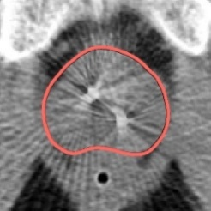
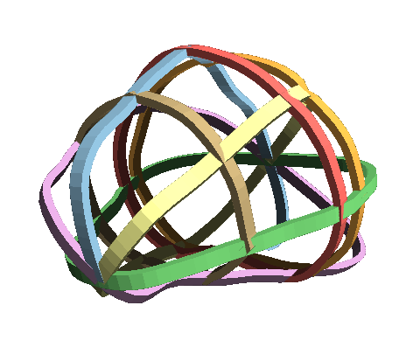
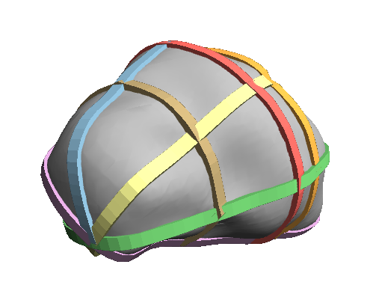
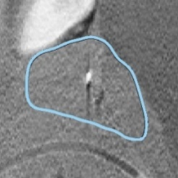
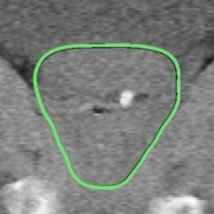
Motivation: Image segmentation
Interaction
Reconstruction
3D Image Volume
Contours on cross-sections
Segmented shape

Slide 3
Motivation: Image segmentation
Interaction
Reconstruction
3D Image Volume
Contours on cross-sections
Segmented shape

Slide 4
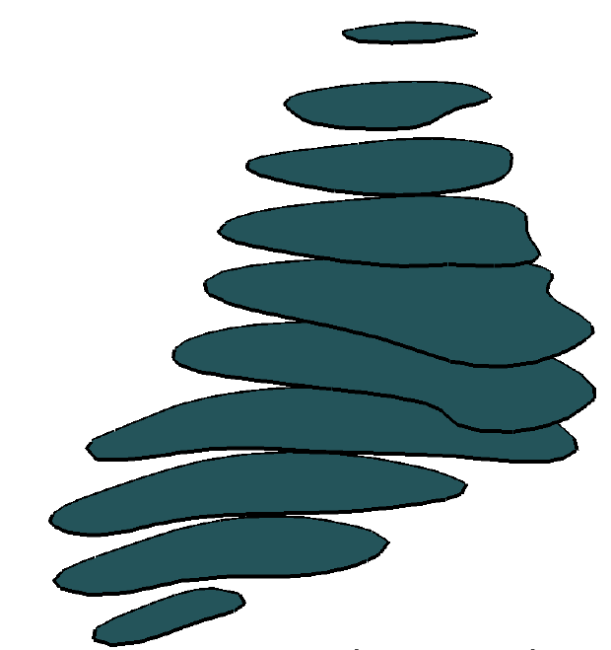
Background: Reconstruction from cross-sections
A well-studied problem dated back to 70s
Parallel planes
Natural choice for 3D images, but may require many cross-sections to describe shape
Non-parallel planes
Well-chosen planes can describe shape with fewer cross-sections [Boissonnat 07, Liu 08, Barequet 09, Bermano 11, Heckel 11, Zou 15, Holloway 16, Huang 17]

Slide 5
Background: Reconstruction from cross-sections
A well-studied problem dated back to 70s
Parallel planes
Natural choice for 3D images, but may require many cross-sections to describe shape
Non-parallel planes
Well-chosen planes can describe shape with fewer cross-sections [Boissonnat 07, Liu 08, Barequet 09, Bermano 11, Heckel 11, Zou 15, Holloway 16, Huang 17]
Extension to model multi-labelled domains from multi-labelled cross-sections

Slide 6
Background: Consistency
Methods handling non-parallel cross-sections require consistent input
Intersecting cross-sections share the same labelling along the intersection line
Consistent
Inconsistent

Slide 7
Background: Consistency
All interpolating methods fail on inconsistent cross-sections
Approximating methods work, but create surface artifacts
[Bermano 11]

Slide 8
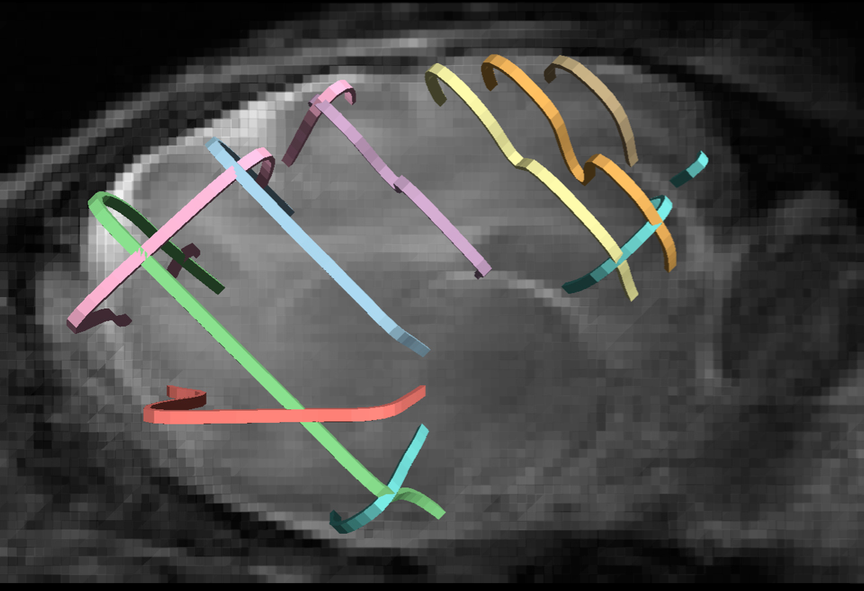
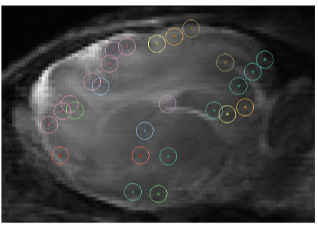
Background: where does inconsistency come from?
Cross-sections are often created independently from each other
We can ask the users/software to be more careful. But…
Adds labor and distraction
Requires changes to existing software
Cannot process existing data

Slide 9
Objective
Given a set of (possibly inconsistent) multi-labelled non-parallel cross-sections
Modify curves on each cross-section to restore consistency
Notes:
Input and output
criteira hard and soft
Challenges
Explicit approach
Challenges (topology changes, criteial of where to snape, how to guarantee the consistency)
Implicit (high level idea)
How to represent the curve as implicit representaion
Whats the
How to fomulate the optimization problem
How to solve

Slide 10
Explicit approach
Geometric deformation of the curve network on each plane
Difficult to enforce consistency
Both the number and location of intersections are unknown
Deformation may introduce new intersections
Cannot change curve network topology
May result in large deformations
Notes:
Input and output
criteira hard and soft
Challenges
Explicit approach
Challenges (topology changes, criteial of where to snape, how to guarantee the consistency)
Implicit (high level idea)
How to represent the curve as implicit representaion
Whats the
How to fomulate the optimization problem
How to solve

Slide 11
Implicit approach
Represent the curve network on each cross-section by an implicit function
Modify the implicit functions
Reconstruct the curve networks from the modified functions
Notes:
Input and output
criteira hard and soft
Challenges
Explicit approach
Challenges (topology changes, criteial of where to snape, how to guarantee the consistency)
Implicit (high level idea)
How to represent the curve as implicit representaion
Whats the
How to fomulate the optimization problem
How to solve

Slide 12
Implicit approach
Easy to enforce consistency
As inequality constraints on the implicit functions
Flexible in topological changes
Notes:
Input and output
criteira hard and soft
Challenges
Explicit approach
Challenges (topology changes, criteial of where to snape, how to guarantee the consistency)
Implicit (high level idea)
How to represent the curve as implicit representaion
Whats the
How to fomulate the optimization problem
How to solve

Slide 13
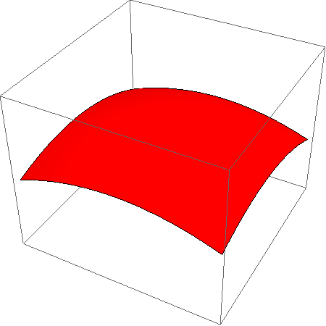
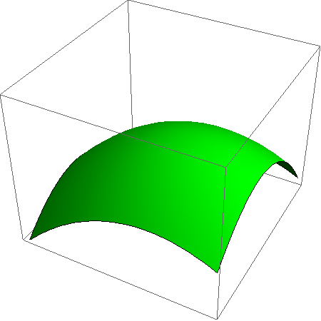
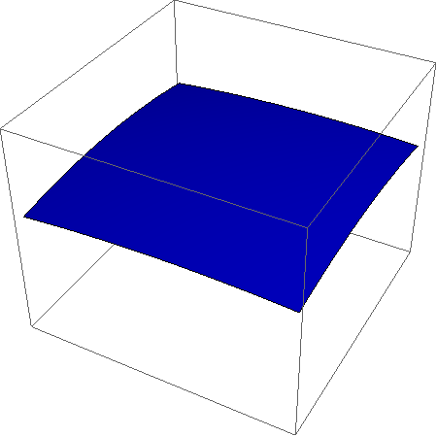
Implicit representation
Representing a $n$-labelled plane: [Losasso 06, Feng 10, Yuan 12, Huang 17]
Define$n$scalar functions $f_{1}\left(x\right),…,f_{n}\left(x\right)$
Label as index of the function that achieves maximum value:
$$Label\left(x\right)={argmax }_{i}{ f_{i}\left(x\right)}$$
Labelled regions are bounded by a non-manifold curve network
$$f_{1}$$
$$f_{2}$$
$$f_{3}$$

Slide 14
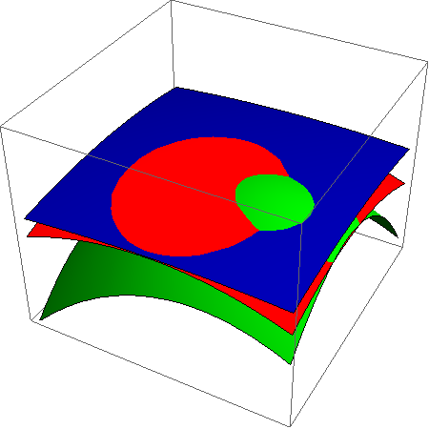
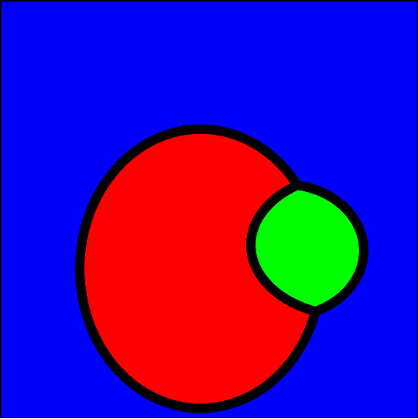
Implicit representation
Representing a $n$-labelled plane: [Losasso 06, Feng 10, Yuan 12, Huang 17]
Define$n$scalar functions $f_{1}\left(x\right),…,f_{n}\left(x\right)$
Label as index of the function that achieves maximum value:
$$Label\left(x\right)={argmax }_{i}{ f_{i}\left(x\right)}$$
Labelled regions are bounded by a non-manifold curve network
$$\{f_{1},f_{2},f_{3}\}$$
$$Label$$

Slide 15
Implicit representation
Define initial scalar functions as signed distance functions
Triangulate each cross-section
Compute $f_{i}^{P}(v)$ for label $i$ at vertex $v$on plane $P$ as signed distance to boundaries of label $i$

Slide 16
Problem formulation
Given implicit functions on each cross-section
Modify the functions so that:
Labelling is consistent on intersection lines
Distortion to curve networks is minimized

Slide 17
Consistency constraints
Consider vertex $v$ on the intersection line between cross-sections $P,Q$
$f_{1,…,n}^{P}\left(v\right),f_{1,…, n}^{Q}(v)$: scalar values on plane $P,Q$
Suppose the final label at $v$ is known, $l(v)$
Then function value of $l(v)$ is greater than any other label at $v$
Since we don’t know $l(v)$, we leave it as a variable.
$$P$$
$$f_{l\left(v\right)}^{P}\left(v\right)≥f_{i}^{P}\left(v\right)+ε, f_{l\left(v\right)}^{Q}\left(v\right)≥f_{i}^{Q}\left(v\right)+ε,$$
$$∀i≠l(v)$$
$$Q$$
$$v$$

Slide 18
Deformation energy
Deviation from input curve networks
How far have the curves moved? (zero order)
How much have the curve tangents changed? (1st order)
$$E\left(f\right) =λ\sum_{P, v, i}{{(f_{i}^{P}\left(v\right)−{\overline{f}}_{i}^{P}\left(v\right))}^{2}}$$
(zero order)
$$+\sum_{P, v, i,j}{{(G\left(f_{i}^{P}−f_{j}^{P}\right)\left(v\right)−G\left({\overline{f}}_{i}^{P}−{\overline{f}}_{j}^{P}\right)\left(v\right))}^{2}}$$
(1st order)
$\overline{f}$: input function; $L$: discrete gradient

Slide 19
Mixed-Integer Programming (MIP)
Continuous variables: $f_{i}^{P}(v)$ // Implicit function values at all vertices
Integer variables: $l(v)$ // Labels at vertices on intersection lines
Minimize: $E(f)$ // Quadratic deformation energy
Subject to: $f_{l\left(v\right)}^{P}\left(v\right)≥f_{i}^{P}\left(v\right)+ε$ // Consistency constraints

Slide 20
Optimization
MIPs are computationally expensive to solve
We propose an efficient solution strategy by iteratively solving Quadratic Programming problems

Slide 21
Quadratic Programming (QP)
For a given set of labels $l(v)$ at each vertex $v$ on intersection lines:
Continuous variables: $f_{i}^{P}(v)$ // Implicit function values at all vertices
Minimize: $E(f)$ // Quadratic deformation energy
Subject to: $f_{l\left(v\right)}^{P}\left(v\right)≥f_{i}^{P}\left(v\right)+ε$ // Consistency constraints

Slide 22
Optimization strategy
Start with an initial set of labels on the intersection lines
By averaging values from multiple planes
Solve QP
Update labels and repeat
Until energy no longer decreases

Slide 23
Updating labels
A set of labels defines a set of inequality constraints
A convex cell in the solution space
Minimizer of QP lies on the boundary of the cell
Otherwise, the input is already consistent

Slide 24
Updating labels
A set of labels defines a set of inequality constraints
A convex cell in the solution space
Minimizer of QP lies on the boundary of the cell
Otherwise, the input is already consistent
Each hyperplane containing the minimizer corresponds to a pair of labels $l\left(v\right),i$ with similar values at some vertex $v$
Setting $l\left(v\right)=i$ potentially lowers the energy

Slide 25
Updating labels
Sort all hyperplanes by magnitude of energy gradient across the hyperplane
Visit each hyperplane, flip label, and compute QP of the new label set
Take the next label set as the first hyperplane with positive reduction in energy

Slide 26
Experiments: Parameter selection
Choosing $λ$: trade-off proximity with shape preservation
Energy = $λ$ * 0-order difference + 1st-order difference
$$λ=100$$
$$λ=1$$
$$λ=0.01$$

Slide 27
Experiments: Performance
Comparing with off-the-shelf MIP solver (Gurobi)
2-labels input: increasing number of cross-section planes
Our method produces similar energy but using significantly less time
# planes | Our energy | Gurobi energy | Our Time (s) | Gurobi Time (s)
2 | 16.65 | 16.65 | 0.845 | 1.05
3 | 24.95 | 24.95 | 1.253 | 11.28
4 | 25.02 | 25.03 | 3.024 | 33.16
5 | 29.55 | 29.55 | 33.218 | 619.91

Slide 28
Experiments: More examples
Atrium (2 labels, 5 planes, time: 1 sec)
[Bermano 11]
Input
Consistent output
Surface from input
Surface from output

Slide 29
Experiments: More examples
Ferret brain (2 labels, 10 planes, time: 66 sec)
$$P$$
$$P$$
Inconsistent

Slide 30
Experiments: More examples
Ferret brain (2 labels, 10 planes, time: 66 sec)
$$P$$
$$P$$
Consistent

Slide 31
Experiments: More examples
Livers (5 planes, 4 labels , total time: 25s)
$$P$$
$$Q$$
$$P$$
$$Q$$
Inconsistent

Slide 32
Experiments: More examples
Livers (5 planes, 4 labels , total time: 25s)
$$P$$
$$Q$$
$$P$$
$$Q$$
Consistent

Slide 33
Experiments: More examples
Mouse brain (6 planes, 7 labels, total time: 421s)
Inconsistent
Consistent

Slide 34
Conclusion
An algorithm for restoring consistency to non-parallel cross-sections
Formulating and solving an MIP on implicit functions
Allowing existing surface reconstruction methods to work on imperfect cross-section inputs
Limitations and future work
Improving deformation energy to better preserve smooth/sharp features
Integration into interactive volume segmentation (real-time feedback to users)

