Slide 1
Topology-controlled reconstruction of multi-labelled domains from cross-sections
Zhiyang Huang, Ming Zou Washington University in St. Louis
Nathan Carr Adobe
Tao Ju Washington University in St. Louis
Notes:
Welcome to our talk, and I am going to talk about reconstructing multi-labeled domain with topology control.

Slide 2
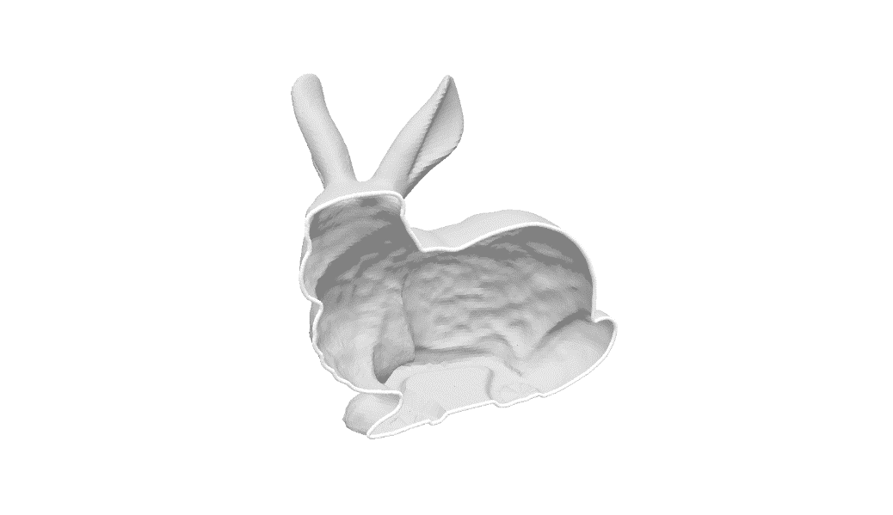
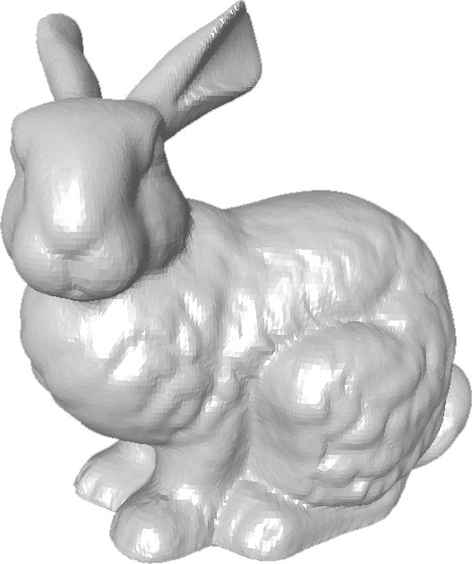
Introduction
Two-labelled domains
Out
In
Boundary surface (manifold)
Notes:
Reconstruction is an important topic in computer graphics. And majority reconstruction methods focus on reconstructing solid object which partitions the space into two labels, inside and outside. These two labels share a common boundary surface which is a manifold surface.

Slide 3
Introduction
Multi-labelled domains
Cortex
Mid-brain
Out
Material interface (non-manifold)
Notes:
However complex object are often made up of compartments of different materials or different functions
For example this mouse brain consists of 14 anatomical regions, and these anatomical regions share a non-manifold surface network as their boundaries, which we call the material interface.

Slide 4
Introduction
Applications of multi-labelled domains
Biomedicine
Manufacturing
Geology
Fluid Dynamics
Notes:
Material interface are used in many different applications across different disciplines, such as biomedicine, manufacturing, geology and physical simulation. I am not going to the hock on any of these applications, the focus of our work is on reconstructing material interfaces that have the correct topology.

Slide 5
Introduction
Topology of material interfaces
2-labels: number and genus (# handles) of boundary surface
Handle
Notes:
Topology is an intrinsic property of a shape that is invariant under continuous deformations.
For two label domain, the topology of a shape is usually measured by the number of components and the number of handles or genus for each component. Here we show a handle on the mug.

Slide 6
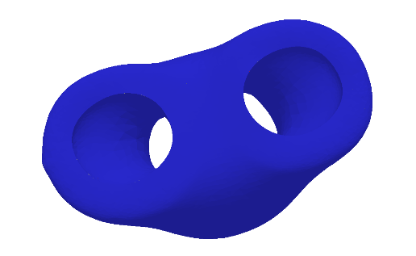
Introduction
Topology of material interfaces
2-labels: number and genus (# handles) of boundary surface
Multiple labels: number/genus of surfaces bounding each label
(outside)
Surface components
1
1
1
genus
2
0
0
Notes:
For multiple label material interfaces, we can measure the number of surfaces of each label and the genus of each surface.
I illustrate the concept using the example in here, on the top we show the exterior surface of a three label domain, the red, blue and outside. And the bottom is the cut-away view of the model, as u can see the red label forming the Y shape that penetrates through the blue label.
Now we can count the number of component and genus per label. For example the blue label is bounded by a single connected surface with genus 2. While the other two labels are bounded by a single genus 0 surface.

Slide 7
Introduction
Many applications require topologically correct reconstructions
Mesh simplification, surface mapping, physical simulation
Simplification [Wood 04]
Surface mapping [Yao 09]
Notes:
Many applications require their model to have the correct topology. And we have seen that in the literature, such as mesh simplification, finding correspondence between surfaces, and performing physical simulation in the domain defined by the material interfaces.

Slide 8
Related works
Reconstructing material interfaces
Surface tracking
From labelled volumes
From cross-sections
Notes:
There are many existing methods for reconstructing material interfaces, some of them perform a surface tracking, others create surfaces from different input data such as labelled volumes and cross-sections, our method belongs to the last category.

Slide 9
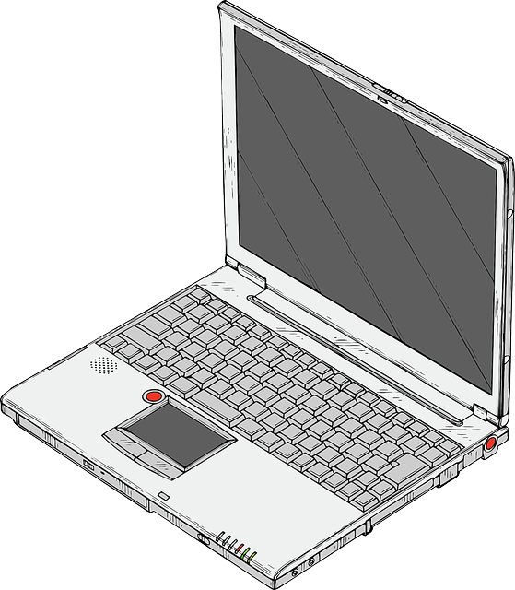
Related works
Reconstructing material interfaces
Surface tracking
From labelled volumes
From cross-sections
3D MRI/CT volume
Segmented 2D slices
Reconstructed material interface
[Bermano 11]
Notes:
These cross-sections often arise from biomedical research. In order to segment region of interest from a 3 dimensional image volume, such as MRI or CT scans, doctors often performs manual segmentation on 2D cross-sections, and the result of that is a stack of labeled 2D cross-sections. Feeding this cross-sections as input, reconstruction methods create the material interface that interpolates the labeling of cross-sections.

Slide 10
Related works
Reconstructing material interfaces
Surface tracking
From labelled volumes
From cross-sections
Geometrically correct, but no topological guarantees
Notes:
However none of these method for reconstructing material interfaces can guarantee a correct topology

Slide 11
Related works
Reconstructing material interfaces from cross-sections [Bermano 11]
Extra handle
Disconnection
Cross-sections
Reconstruction
Topological errors
Notes:
And I have shown a quick example here and you see a example from Bermano et al in 2011. Giving the input cross-sections, their method create the material interfaces that has multiple topological errors, such as an extra handle or disconnected components.
Notices that these labels are intertwined with each other, it is difficult to fix the topological problem of one label without destroying the topology of the other.

Slide 12
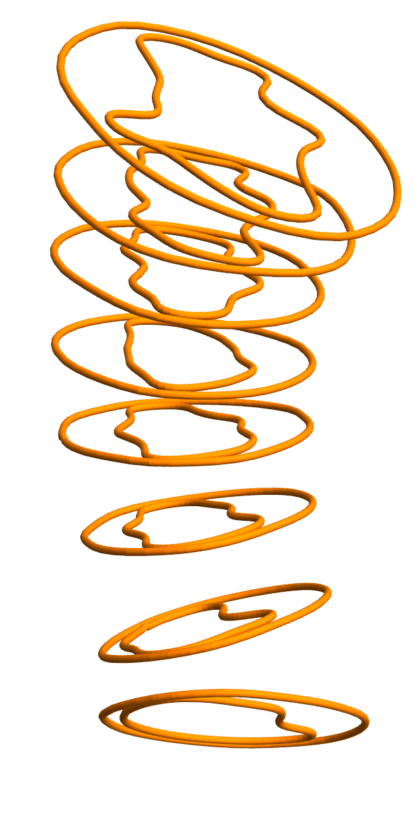
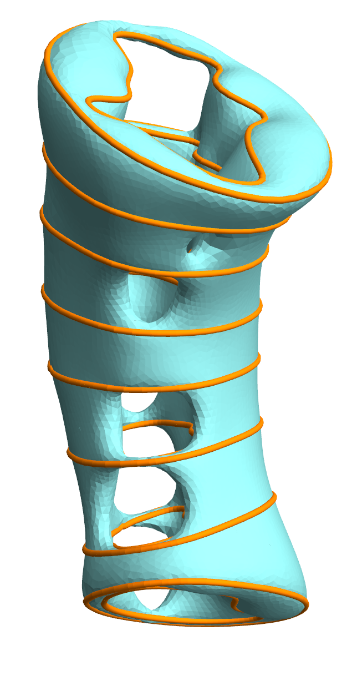
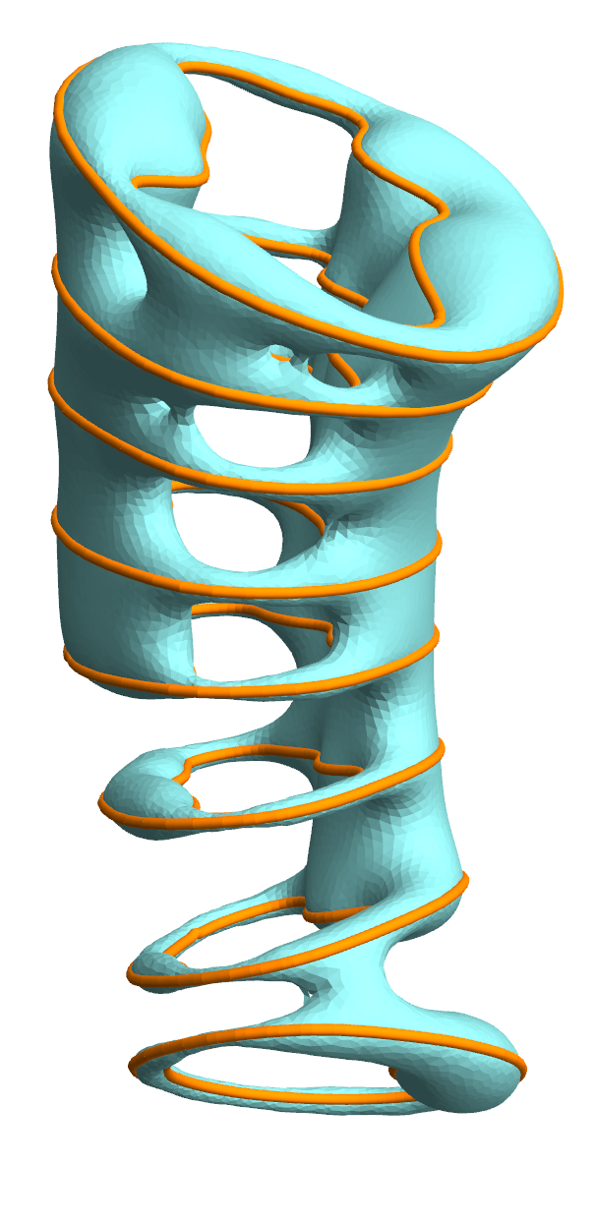
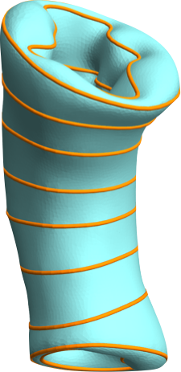
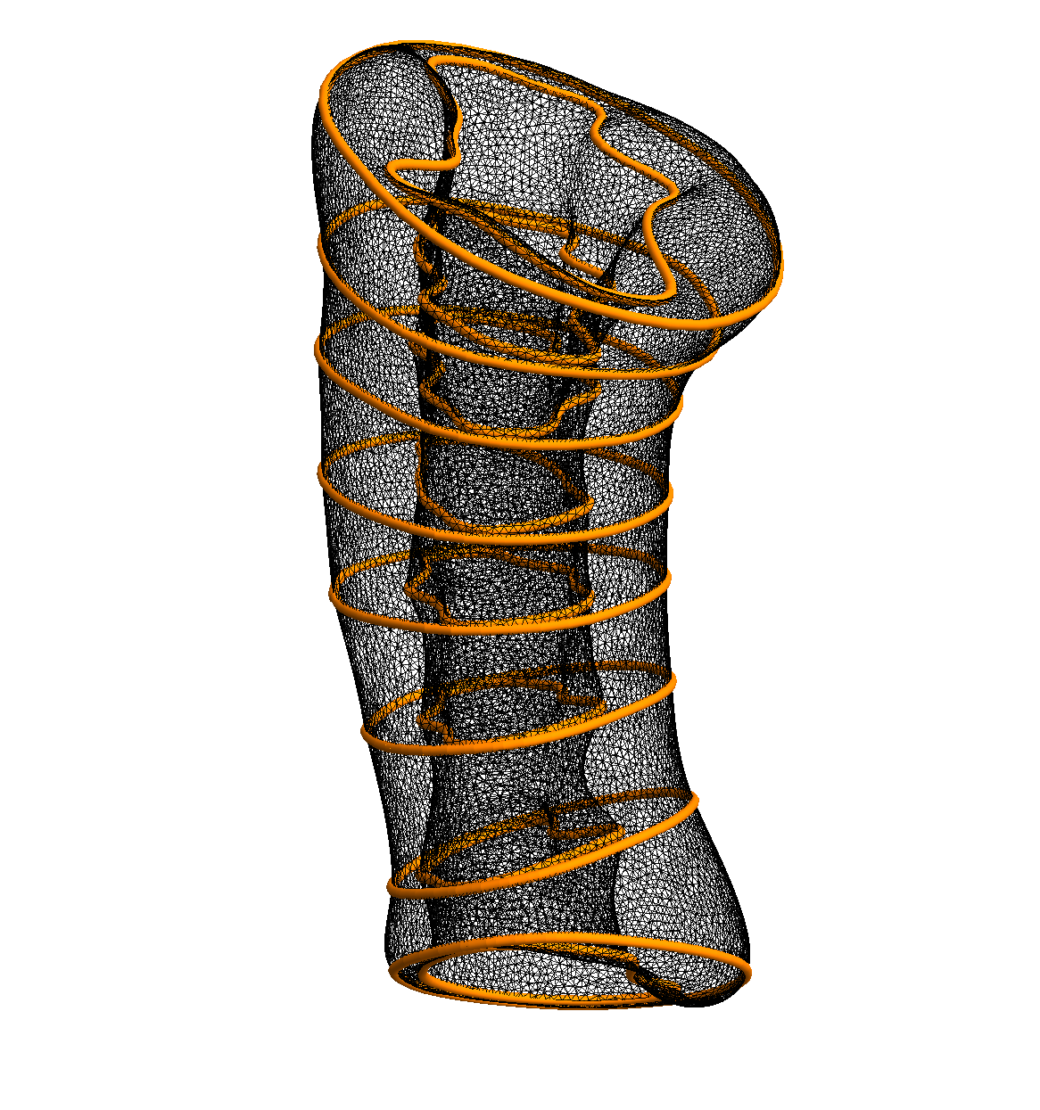
Related works
Topology-aware modeling of 2-labelled domains
Topology repair
Reconstruction with topology control
Do not handle multiple labels
Independent reconstruction of individual labels leads to intersecting material interface
[Sharf 07]
Input
[Liu 08]
[Bermano 11]
Genus-1 [Zou 15]
Notes:
There are also classes of methods for repairing bad topologies or reconstruction with topology control, but they are limited to two label domains.
For example sharp et al at 2007, provide interactive approach for reconstructing from point cloud, while Zou et al in 2015, which is a very similar work of ours, reconstructed from cross-sections, a topologically correct two label surface.
As I mention before these methods are limited to two label domains, and hence could not be easily extended to handle multi-label material interfaces. Naive application of these method to each label in the domain would easily causes intersecting material interfaces that are geometrically incorrect.

Slide 13
Our work
Reconstructs material interfaces from cross-sections
Allowing any number of labels and non-parallel planes
Automatic and interactive topology control
Global constraints (components and genus per label)
Interactive sketching
Notes:
So our work try to fill the gap in material interface modeling by developing an algorithm of reconstructing material interface from cross-sections. The algorithm handles arbitrary number of labels and planes, whether they are parallel or not.
And the key feature of our method is that the user has control of topology of the final result, in two forms. User can choose to specify the number of components and genus for any set of labels, and the user can also modify the result using interactive sketching.

Slide 14
Our work
Extra handle
Disconnection
w/o topology constraints
with topology constraints (yellow/green: genus 0)
Notes:
Here we compare the result with and without topological constraint.
As we have seen before on the top row, without topological constraint, reconstruction methods can easily create material interface that has extra handles or broken components. And the bottom row shows our result with constraint such that both yellow and green labels are bounded by a single genus 0 surface. Again this is a challenging task as these two labels are adjacent to each other, so fixing the topology of one label could not be done independently of the other label. Their topological properties are closely related.

Slide 15
Technical contributions
Extending the divide-and-conquer paradigm of [Zou et al. 15]
From 2-labels to multiple labels
Introducing a new implicit definition of material interfaces
Allowing systematic exploration of topological variations
Notes:
Technically, we extend the divide and conquer paradigm of Zou et al in 2015, from 2 labels to multiple labels. the key contribution, in our opinion, is introducing a new definition of material interface that allow us to explore a variety of material interfaces with different topologies.

Slide 16
Divide-and-conquer
Cross-section planes divide space into cells
Notes:
First we describe the divide and conquer paradigm,
Giving input cross-sections we first divide the bounding box into polyhedral cells using cross-sections. And we work within each cell.

Slide 17
Divide-and-conquer
Cross-section planes divide space into cells
Within each cell, explore and score candidate surface topologies
Pick one per cell to meet the topological constraint while maximizing score
Topo Constraint
Notes:
In the first step, we enumerate material interfaces with different topology within each cell. Now each of these material interfaces will interpolate the boundary of the cell. And notice that some cells may have larger variety of topologies than other cells and it depends on the complexity of the labeling on the boundaries.
In the second step, we will pick one topology per cell such that by combining these surfaces together, we meet the global topological constraint and the sum of geometry score is maximized.
Here we use red color to illustrate the constraint and gray color means no constraint is imposed. Now in this case the topological constraint ask the red label to be bounded by a single genus 0 surface and the blue label bounded by two genus 0 surfaces.

Slide 18
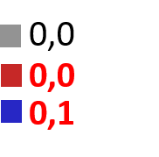
Divide-and-conquer
Cross-section planes divide space into cells
Within each cell, explore and score candidate surface topologies
Pick one per cell to meet the topological constraint while maximizing score
Topo Constraint
Notes:
With different topological constraints, our algorithm can produce a different material interfaces all conforming to particular topology constraints.
In the second example the blue label is constrained to be bounded by two surfaces, one of which has genus one while the red label is bounded by two genus 0 surfaces.

Slide 19
Divide-and-conquer
Cross-section planes divide space into cells
Within each cell, explore and score candidate surface topologies
Pick one per cell to meet the topological constraint while maximizing score
Notes:
We will focus on the first step on this talk. The second step is very similar to Zou et al two years ago, and please refer to the paper for details.
The key to the first step is to be able to define multiple material interfaces with different topology, and to be able to do that, we draw inspirations from level sets, which are material interfaces for 2-labelled domains.

Slide 20
2-Labels: Level sets
Scalar function $f\left(p\right)$ for $p∈R^{d}$
Scalar “level” $c$
Level set: $\left\{ p \right| f\left(p\right)=c \}$
$$f(p)$$
Notes:
A level set is defined by a scalar function and a scalar value, known as the “level”. The level set consists of all those points where the function values equal the level. The level set naturally divides the domain into two labels, depending on whether the function is greater or smaller than the level.
Here is an example of scalar function defined on a 2D plane. The function is visualized as a terrain over the plane.

Slide 21
2-Labels: Level sets
Scalar function $f\left(p\right)$ for $p∈R^{d}$
Scalar “level” $c$
Level set: $\left\{ p \right| f\left(p\right)=c \}$
$$f(p)$$
$$c$$
Notes:
Intuitively, the level set can be obtained by intersecting the terrain with a horizontal plane whose height is the level,
and projecting the intersection curve back to the plane.

Slide 22
2-Labels: Level sets
Scalar function $f\left(p\right)$ for $p∈R^{d}$
Scalar “level” $c$
Level set: $\left\{ p \right| f\left(p\right)=c \}$
$$f(p)$$
$$c$$
Notes:
As the level changes, the plane moves up and down, and its intersection with the terrain changes. Note that as the plane continues to move, the topology of the intersection curve may change.

Slide 23
2-Labels: Level sets
Scalar function $f\left(p\right)$ for $p∈R^{d}$
Scalar “level” $c$
Level set: $\left\{ p \right| f\left(p\right)=c \}$
$$f(p)$$
$$c$$
Notes:
Here a curve is split into two,

Slide 24
2-Labels: Level sets
Scalar function $f\left(p\right)$ for $p∈R^{d}$
Scalar “level” $c$
Level set: $\left\{ p \right| f\left(p\right)=c \}$
$$f(p)$$
$$c$$
Notes:
and now one of the two curves disappears.
To explore the different level set topology, the key observation is that there are only a finite number of levels where the level set changes topology.

Slide 25
2-Labels: Level sets
Critical values: levels $c$ at which level set changes topology
Divides levels into ranges with distinct level set topology
Associated with critical points of $f$
Notes:
These levels are called critical values. They divide the 1-dimensional axis of level into ranges.
As the level changes within each range, the level set maintains the same topology. To enumerate different level set topologies, we only need to compute the critical values.
It is well-known that these values are associated with critical points of the scalar function, such as local maxima, minima, and saddles.
While the level sets offer a systemic way to explore 2-labelled domains with different topology, we can generalized this capability to multiple labels.

Slide 26
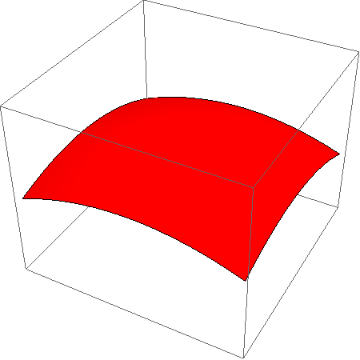
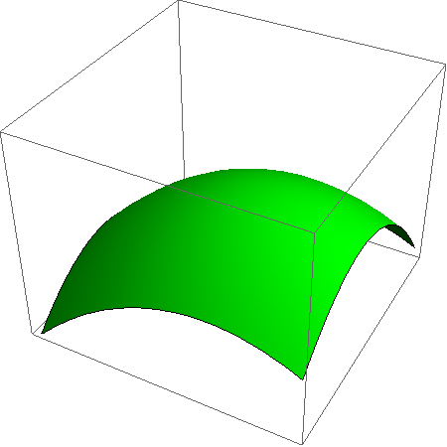
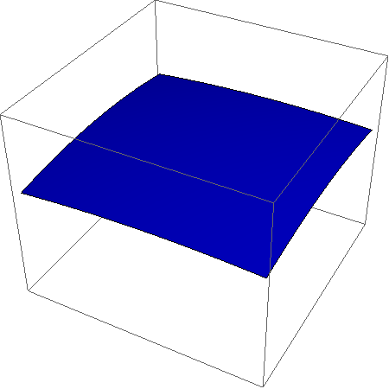
n-labels: Interface sets
Vector function $\overset{⃑}{f}\left(p\right)=\{f_{1}\left(p\right),…,f_{n}\left(p\right)\}$
Vector “offset” $\overset{⃑}{c}=\{c_{1},…,c_{n}\}$
Interface set:
$$f_{1}(p)$$
$$f_{2}(p)$$
$$f_{3}(p)$$
$$\left\{p \right| \left\|{argmax }_{i}{ (f_{i}\left(p\right)+c_{i})}\right\|>1\}$$
Notes:
To define a domain with n labels, we use a vector function made up of n scalar functions. Each scalar function can be considered as the distribution of that label over the domain.
Instead of a scalar level, we use a vector parameter, which we call an offset.
We define the interface set, which is a generalization of level set, as the loci where two or more functions achieve the highest value after adding the offset. The interface set naturally divides the space into n labels, and the label of each point is the scalar function that has the highest value there after adding the offset.
Here we illustrate how to define a 3-labelled domain over the plane. We start from a vector function with 3 scalar functions, shown here as three colored terrains. To define the interface set, we superimpose the three terrains.

Slide 27
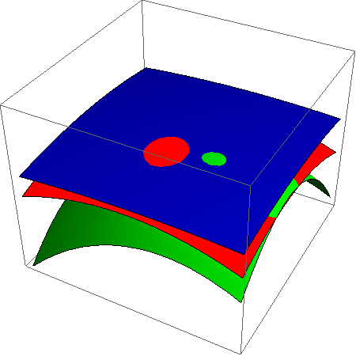
n-labels: Interface sets
Vector function $\overset{⃑}{f}\left(p\right)=\{f_{1}\left(p\right),…,f_{n}\left(p\right)\}$
Vector “offset” $\overset{⃑}{c}=\{c_{1},…,c_{n}\}$
Interface set:
$$\overset{⃑}{f}\left(p\right)$$
$$\left\{p \right| \left\|{argmax }_{i}{ (f_{i}\left(p\right)+c_{i})}\right\|>1\}$$
Notes:
And vertically shift each terrain by its corresponding offset.

Slide 28
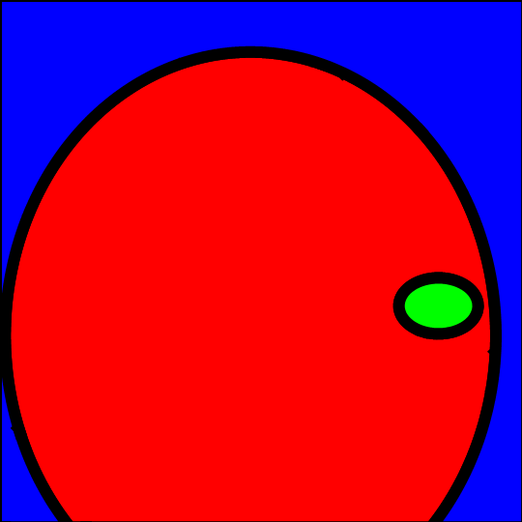
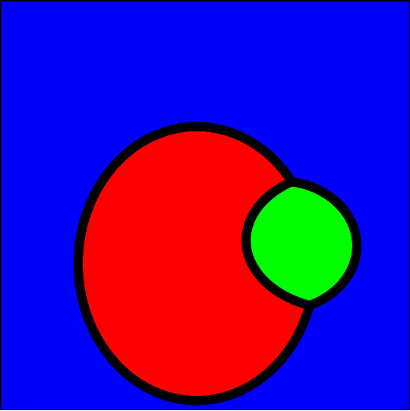
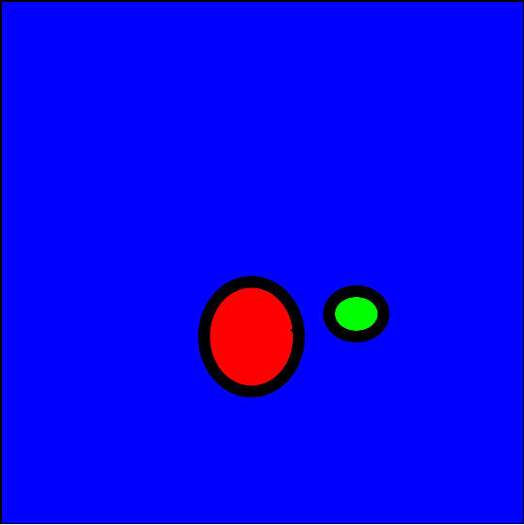
n-labels: Interface sets
Vector function $\overset{⃑}{f}\left(p\right)=\{f_{1}\left(p\right),…,f_{n}\left(p\right)\}$
Vector “offset” $\overset{⃑}{c}=\{c_{1},…,c_{n}\}$
Interface set:
$$\overset{⃑}{f}\left(p\right)+\overset{⃑}{c}$$
$$c_{1}$$
$$c_{2}$$
$$c_{3}$$
0
$$\left\{p \right| \left\|{argmax }_{i}{ (f_{i}\left(p\right)+c_{i})}\right\|>1\}$$
Notes:
If the offsets are zero, the terrains are unchanged. The terrains intersect at a network of curves.
The interface set is the projection of those terrain intersections that are visible from the above. The labelling of the plane is precisely the color of the terrain as viewed from above. As the offset changes, the terrains move up and down, and the interface set changes in both geometry and topology.

Slide 29
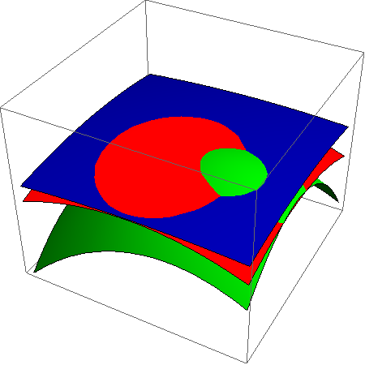
n-labels: Interface sets
Vector function $\overset{⃑}{f}\left(p\right)=\{f_{1}\left(p\right),…,f_{n}\left(p\right)\}$
Vector “offset” $\overset{⃑}{c}=\{c_{1},…,c_{n}\}$
Interface set:
$$\overset{⃑}{f}\left(p\right)+\overset{⃑}{c}$$
$$c_{1}$$
$$c_{2}$$
$$c_{3}$$
0
$$\left\{p \right| \left\|{argmax }_{i}{ (f_{i}\left(p\right)+c_{i})}\right\|>1\}$$
Notes:
For example, by lowering the blue offset, the red and green labels touch and the interface set becomes a curve network.

Slide 30
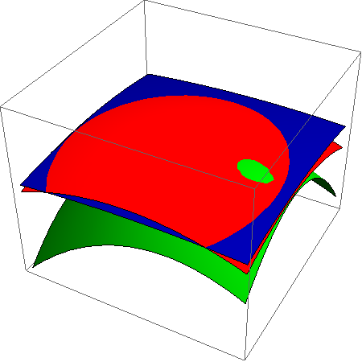
n-labels: Interface sets
Vector function $\overset{⃑}{f}\left(p\right)=\{f_{1}\left(p\right),…,f_{n}\left(p\right)\}$
Vector “offset” $\overset{⃑}{c}=\{c_{1},…,c_{n}\}$
Interface set:
$$\overset{⃑}{f}\left(p\right)+\overset{⃑}{c}$$
$$c_{1}$$
$$c_{2}$$
$$c_{3}$$
0
$$\left\{p \right| \left\|{argmax }_{i}{ (f_{i}\left(p\right)+c_{i})}\right\|>1\}$$
Notes:
By raising the red and green offsets, the green label becomes surrounded by the red label, and the interface set again consists of two separate curves.
This definition gives us a space of material interfaces parameterized by not one, but n parameters.

Slide 31
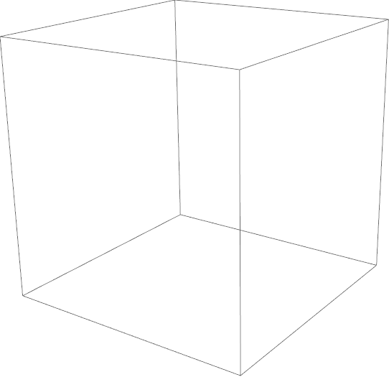
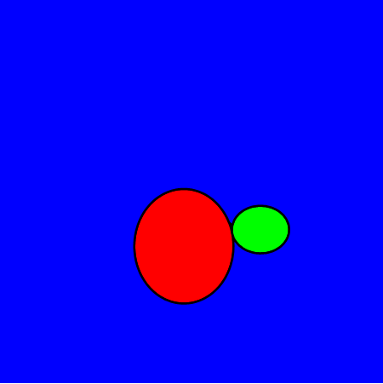
n-labels: Interface sets
$$c_{1}$$
Critical offset: vectors $\overset{⃑}{c}$ at which interface set changes topology
Offset space
$$c_{3}$$
$$c_{2}$$
Notes:
We call this n-dimensional space of offset vectors the Offset Space. Each point in this space defines an interface set.
If two interface sets have different topology, then for any path connecting the two corresponding points in the offset space,
there is some offset vector that defines a “singular” topology – or the transition between the two different topologies.
Such offset vector is called a critical offset, and they are the counterparts of critical values in a scalar function. As we mentioned earlier, there are only a finite number of critical values in a scalar function, which makes it straightforward to enumerate level sets of different topology. However, for three or more labels, critical offsets of a vector function form a continuous complex in the offset space.

Slide 32
n-labels: Interface sets
Cell 1
Critical offset: vectors $\overset{⃑}{c}$ at which interface set changes topology
Divides n-D space into cells with distinct topologies of interface sets
We give a greedy algorithm for exploring topological cells
Using piece-wise constant $\overset{⃑}{f}$
Offset space
Cell 4
Cell 2
Cell 3
Notes:
The complex divides the offset space into cells, within which all interface sets have a same topology. Due to the high-dimension of the offset space, it is both challenging and computationally expensive to directly construct the critical offset complex. We believe this is one of the most interesting directions of future research.
For this work, we propose an approximate algorithm that explores the cells in the offset space using a ray-shooting strategy. Although it is a greedy algorithm and so far it only works on piece-wise constant vector functions, the algorithm can find many useful interface set topologies within reasonable time even for a large number of labels.

Slide 33
Vector function
Harmonic vector function within each cell
Interpolates labelling on cell boundary
$$\overset{⃑}{f}=\{f_{1},f_{2},f_{3}\}$$
Explored topologies
Notes:
Now I will describe how the interface set is used for exploring topologically different material interfaces in each cell. So giving a cell with its labeled boundary, we need to define a vector function such that the interface set all interpolate the boundary and do so in a natural way. Because of this we consider a harmonic vector function with appropriate boundary conditions. And we do that in a discretize domain as shown here, and this is the result of our exploration algorithm for interface set, as you can see these topologies all represent a plausible ways in which the boundary labels are connected in the interior of the cell.

Slide 34
Examples
Input
(5 cross-sections, 6 labels)
Reconstruction w/o constraints
Reconstruction with constraints
More constraints (5 labels, 212 secs)
Notes:
Here we show more examples of our result, this is an input cross-section consists of 5 planes and 6 labels representing a human liver
Reconstructing without topological constraint create multiple topological errors indicating by the black arrows, such as isolated components and extra tunnel, as well as two regions, the blue and purple, that are supposed to be completely wrapped around by the cyan region. Now to correct this error, the user impose constraints on the subset of labels, and notices that our algorithm does not require the user to introduce constraint to all labels. This setting fix most of the topology errors, however, the purple region is still exposed to the outside. And this prompt the user to impose additional constraints on the two labels, and yielding a topologically correct result.

Slide 35
Examples
Input cross-sections
(13 planes, 8 labels)
Reconstruction
(5 constrained labels, 2758s)
Notes:
So this is probably the most complicate example we try using our method. The input consists of 13 planes, representing 8 anatomical regions of a developed chicken heart. And a correct result is achieve with our method by constraint the topology on 5 of 8 labels.

Slide 36
Examples
w/o constraint:
Genus 2
w constraint:
Genus 1
Input cross-sections
(13 planes, 8 labels)
Yellow label
Notes:
Here is a close look at the yellow region, which is barely deep inside the structure. Without topological constraints, the reconstructed surface has two genus, and one of them is incorrect tunnel shown in the highlight.
With the constraint, our algorithm successfully remove that wrong tunnel while reserving the other correct tunnel.

Slide 37
Interaction
Selecting candidate topology
Sketching new topology
Modifying the vector function
Notes:
And we also offer user interactive way to correct result if the algorithm is not able to come up with a desired topology or a desired structure of the shape.
For example in this case even though each label has the correct number and genus of surfaces, the branching structure is incorrect, and using the sketching, the user can change the branching structure of the green label, without violating the topological constraints. For details please see the paper.

Slide 38
Summary
First algorithm for modeling multi-labelled domains with topology control
Interface sets for topology exploration of material interfaces
Limitations
Topology exploration is computational expensive
The space of explored topologies is often insufficient
Notes:
In summary, we present the first algorithm for topological aware modeling on multi-label domain, and we introduce a definition of interface set that generates a family of topologically different material interfaces.
Some limitations that we would like to address in the future including improving the computation efficiency of topology exploration, currently it takes up to an hour for the complicated model such as the developed chicken heart we shown before, and on the other aspect being able to explore a larger variety of material interface topology within each cell.

Slide 39
Future work
Analysis of interface sets topology
Critical points/offsets, their types, connectivity
Consider other topological properties
Adjacency of labels, topology of non-manifold junctions
Extension to other inputs and to topology repair
Notes:
And our work opens up a number of interesting venues for future research, for example we are looking into analytical formulations of critical offsets of our interface set as well as other interesting property of these critical offset such as their type and their connectivity.
We would also like to consider additional topological properties such as the adjacency relation between labels, or the topology of the non-manifold junction curves networks.
Last but not the least, we believe our method can be extended to handle other type of input such as labeled volume or point clouds and further to be able to repair an input material interface with incorrect topology.

Slide 40
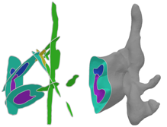
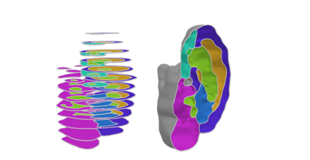
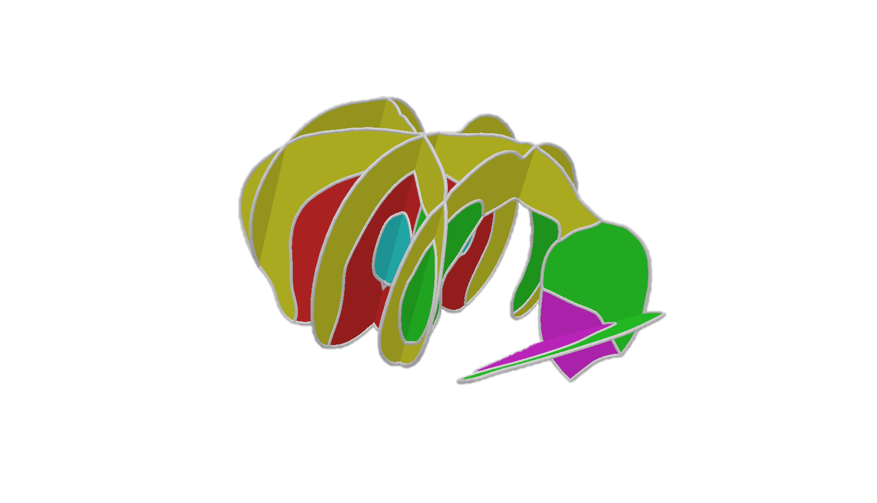
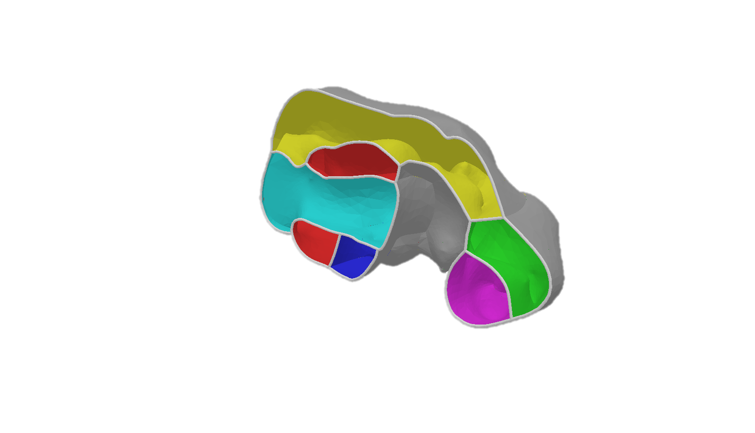
Thank you!
Q&A
Notes:
And thank you very much for listening the talk, I am happy to take questions.

